Slide 1
Introduction to Robotics Course no. 4
Andrei Dumitriu
andrei.dumitriu@fmi.unibuc.ro
Faculty of Mathematics and Computer Science
University of Bucharest

Slide 2
Today’s plan
7 segment display
Buttons
Interrupts

Slide 3
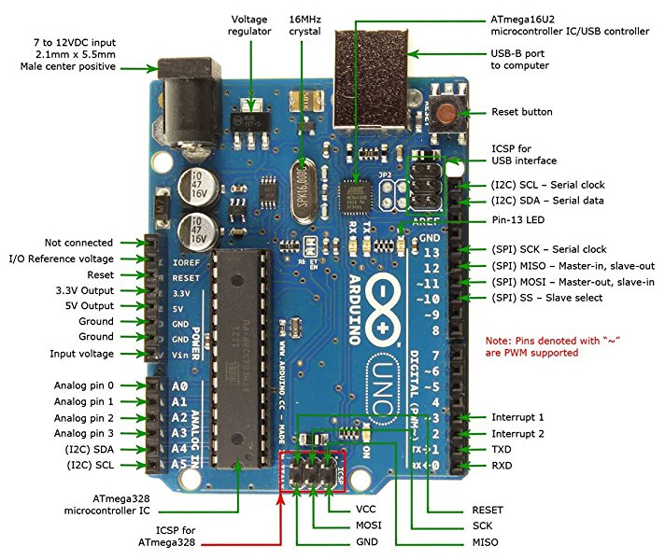
Arduino Uno board

Slide 4
Basic Notations
VCC - Voltage Common Collector = the voltage of the source
GND - Ground = the reference value for the current in the circuit (in our case)
For more details of different types of ground check the following article https://www.autodesk.com/products/eagle/blog/how-does-ground-work-in-electronics/
Ax (e.g. A0) - analogic pin
Dx (e.g.D12) - digital pin

Slide 5
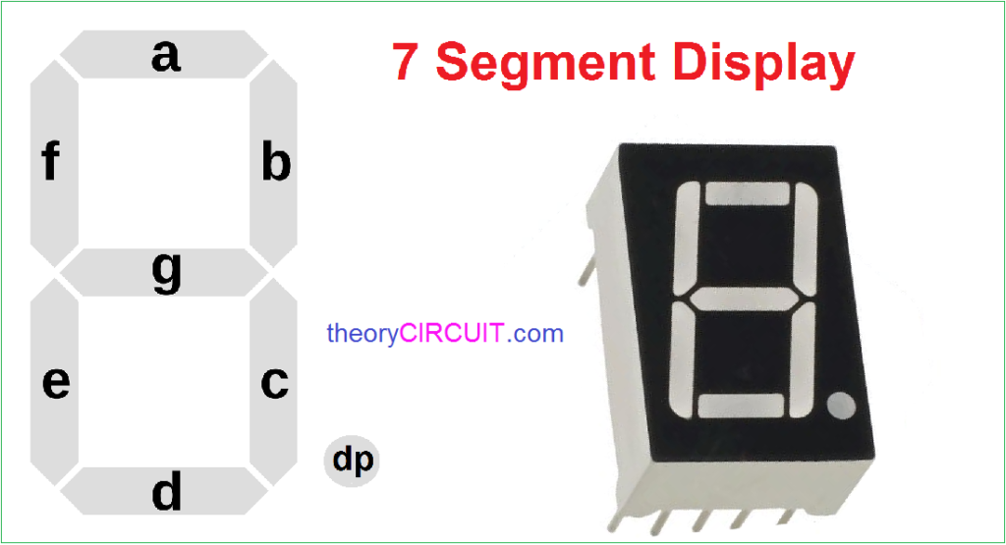
7 segment display
What are they?

Slide 6
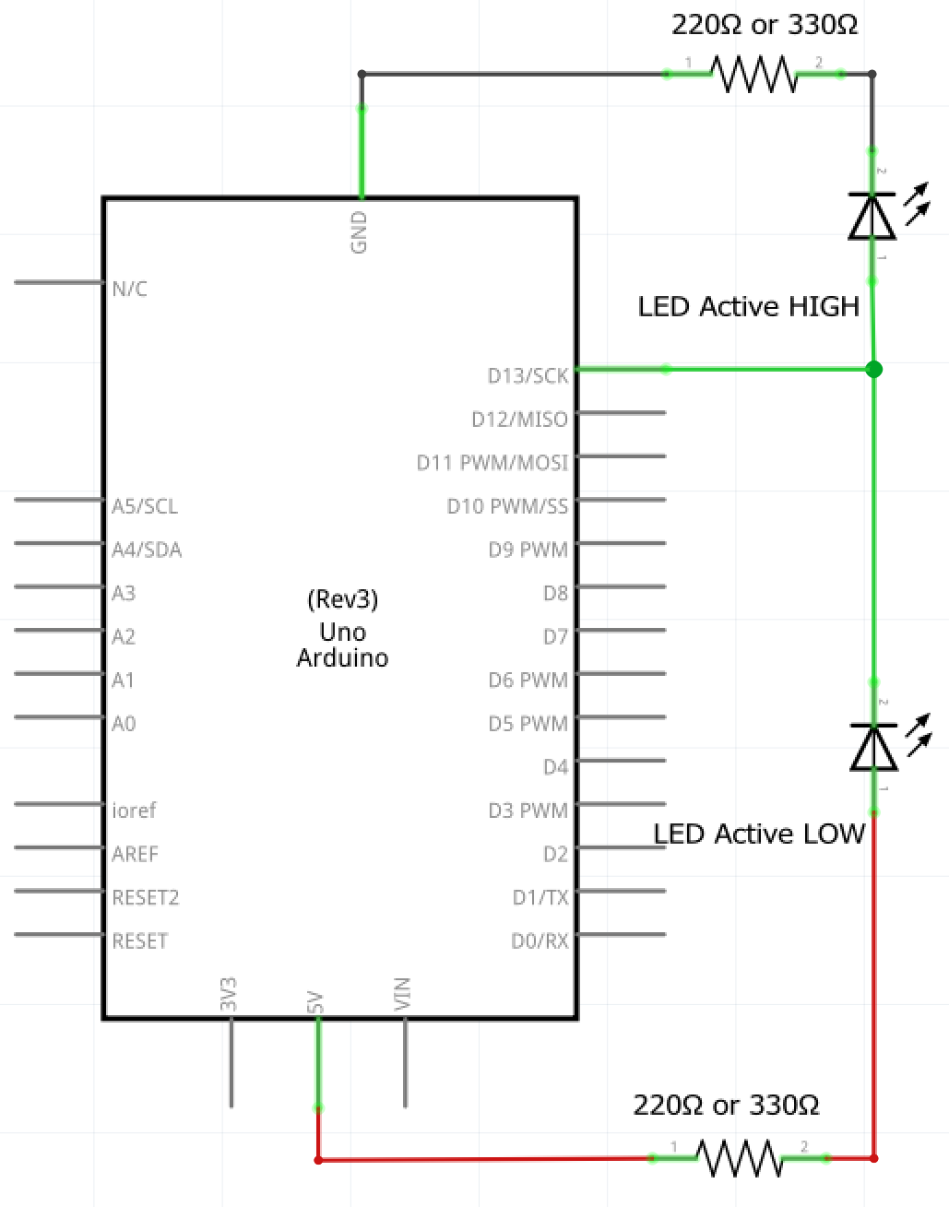
Active HIGH
vs active LOW

Slide 7
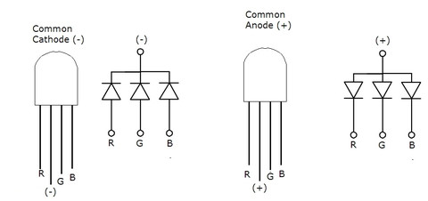
RGB Common Cathode (Active HIGH) vs Common Anode (Active LOW)

Slide 8
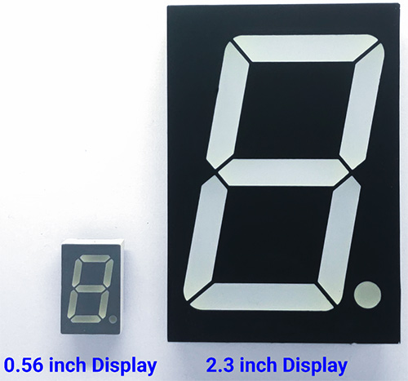
7 Segment display
A bunch of LED’s (how many?) connected in a similar way to the RGB: common anode or common cathode

Slide 9
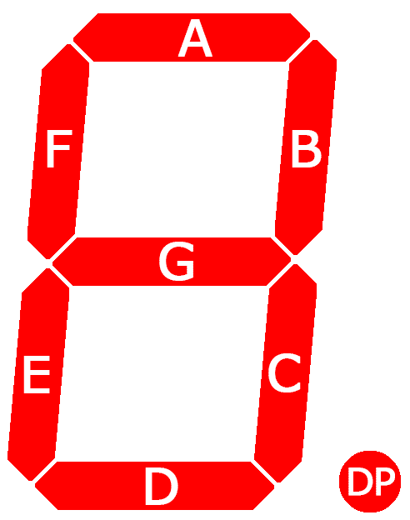
7 Segment display
A bunch of LED’s (how many?) connected in a similar way to the RGB: common anode or common cathode

Slide 10
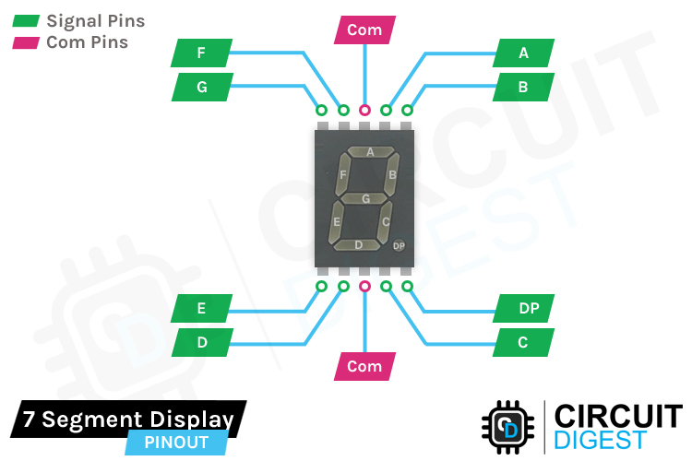
7 Segment display
A bunch of LED’s (how many?) connected in a similar way to the RGB: common anode or common cathode

Slide 11
7 Segment display
A bunch of LED’s (how many?) connected in a similar way to the RGB: common anode or common cathode

Slide 12
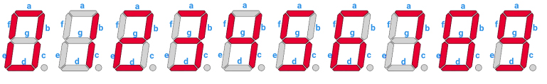
7 Segment display

Slide 13
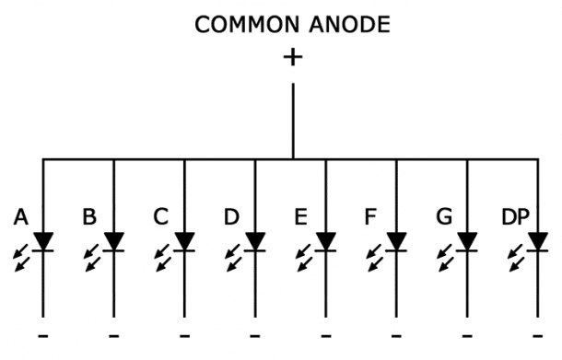
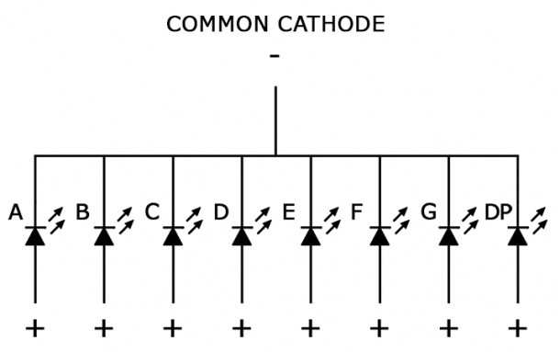
7 Segment display
A bunch of LED’s (how many?) connected in a similar way to the RGB: common anode or common cathode

Slide 14
7 Segment display: common cathode

Slide 15
7 Segment display: common anode

Slide 16
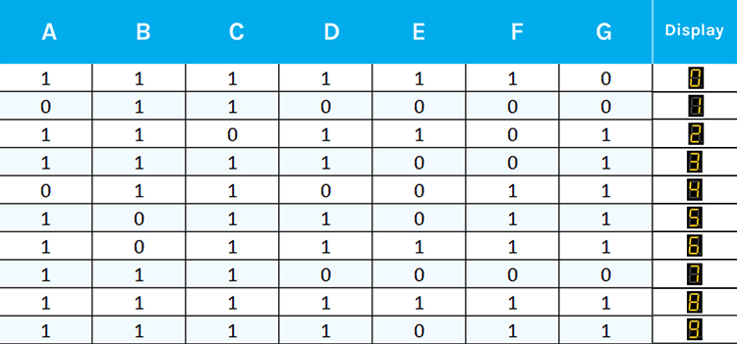
7 Segment display: 0 to 9

Slide 17
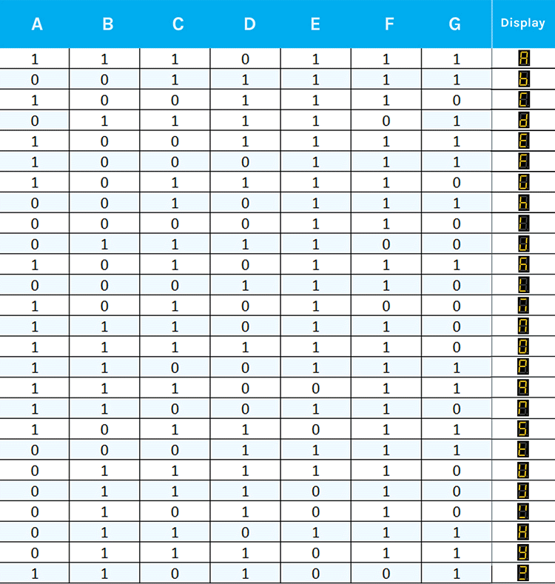
7 Segment display: alphabet

Slide 18
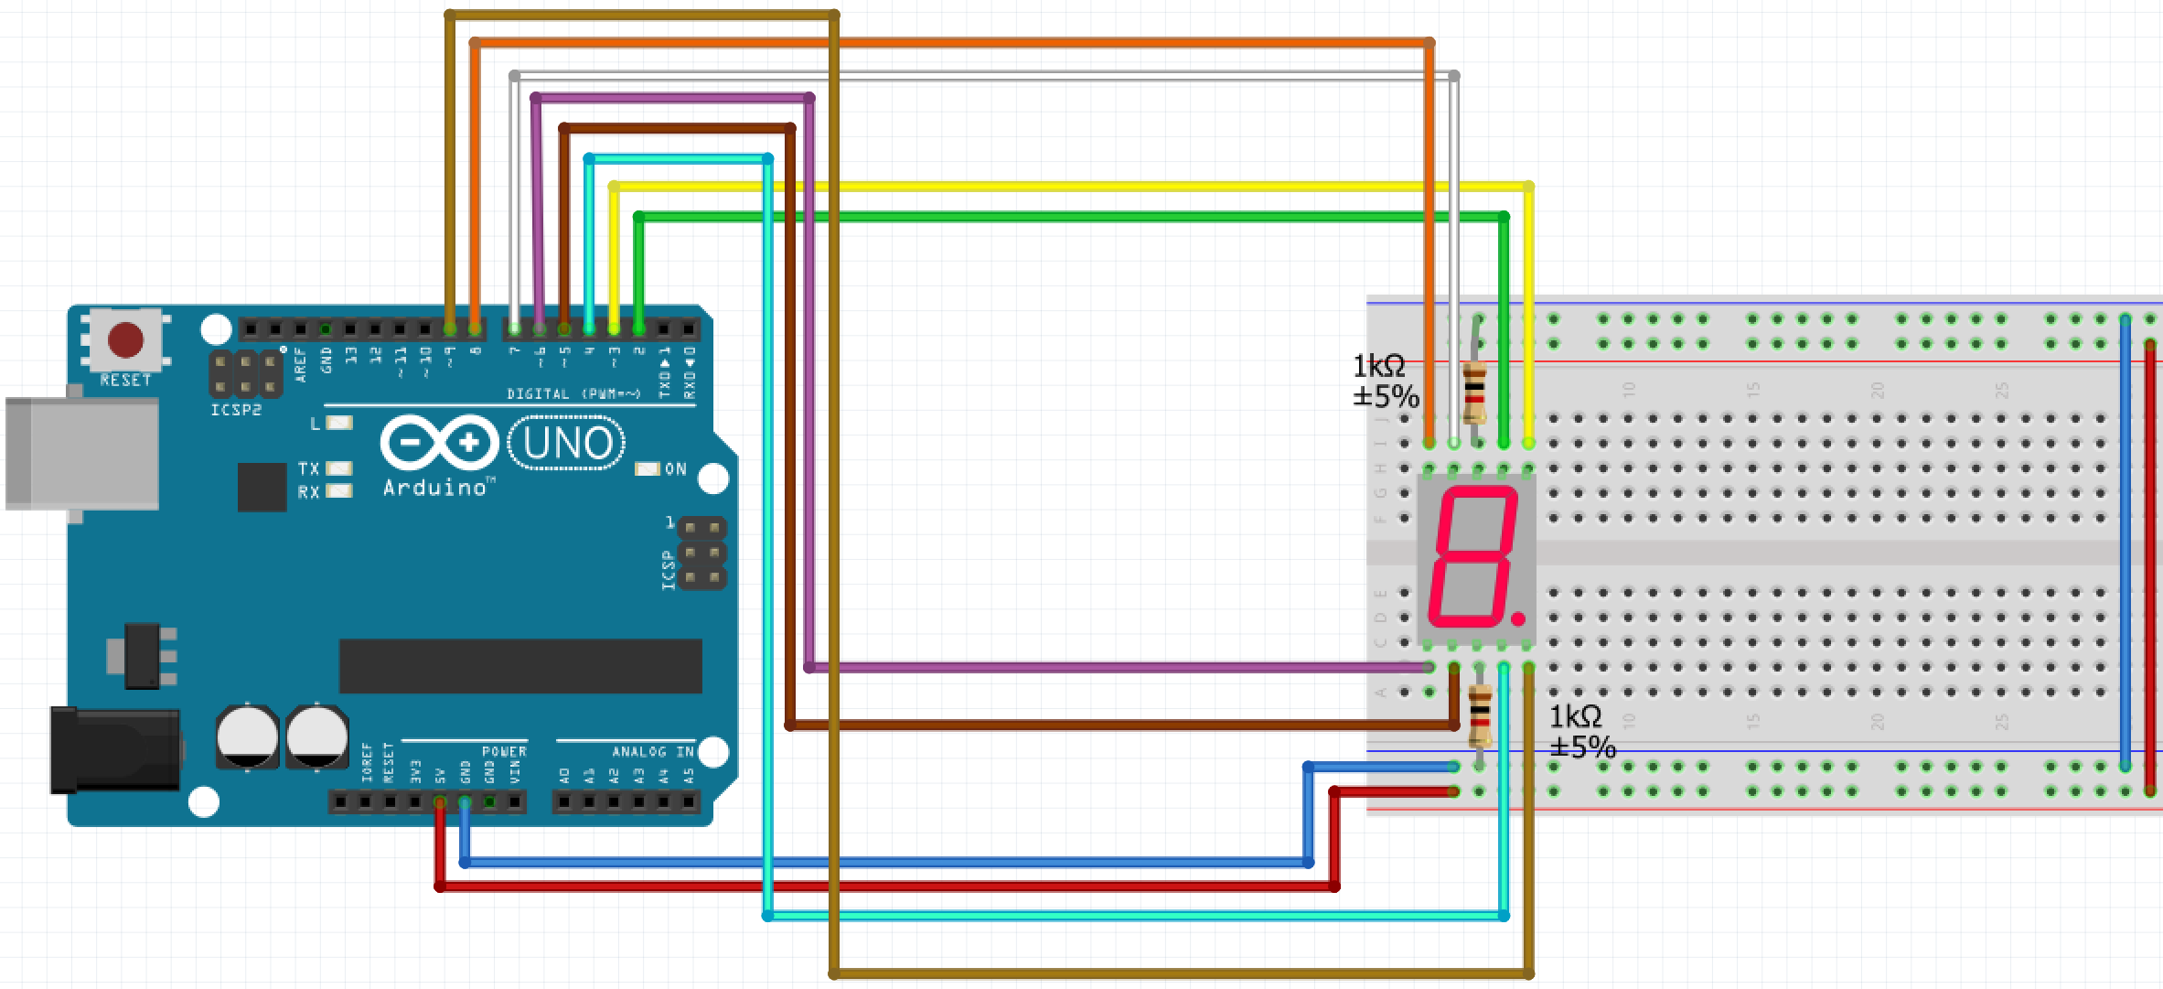
What is wrong with this?

Slide 19
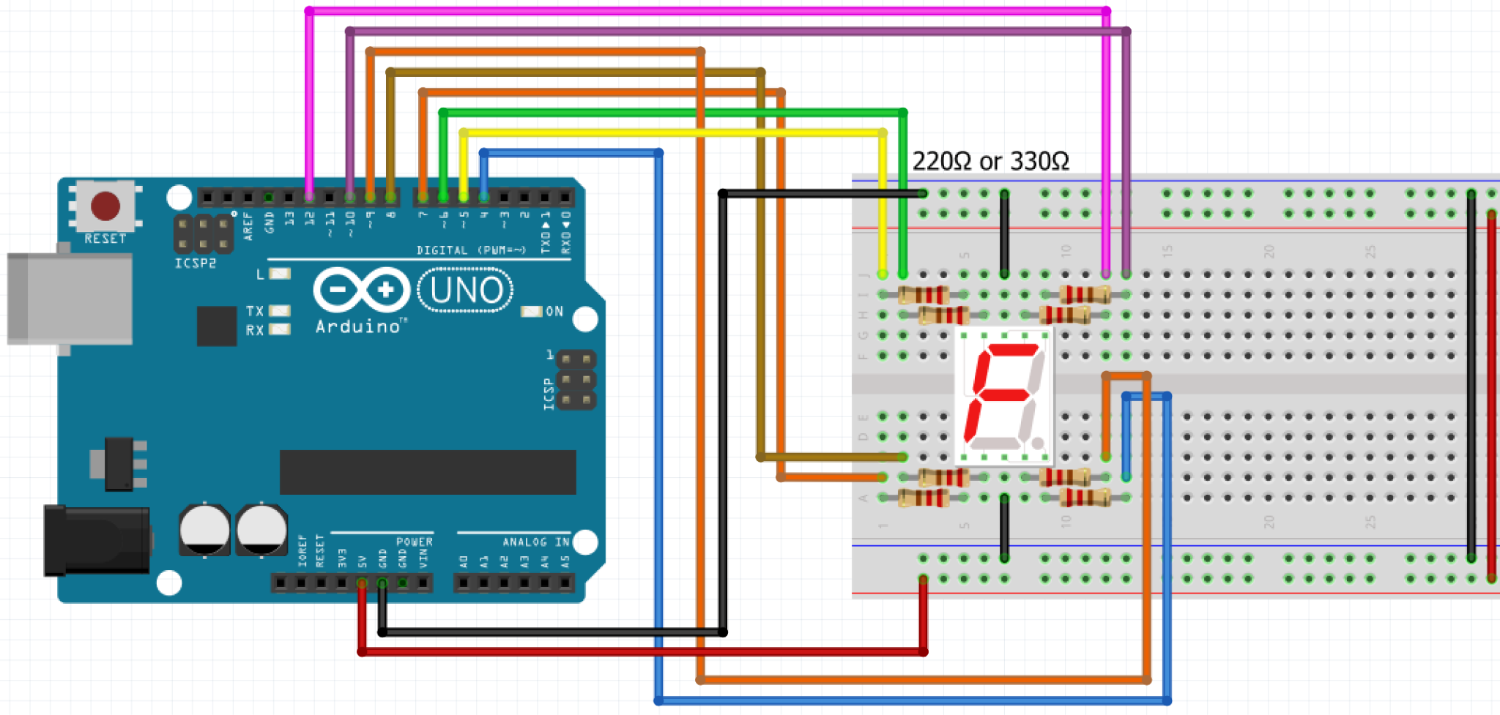
7 Segment display: common cathode

Slide 20
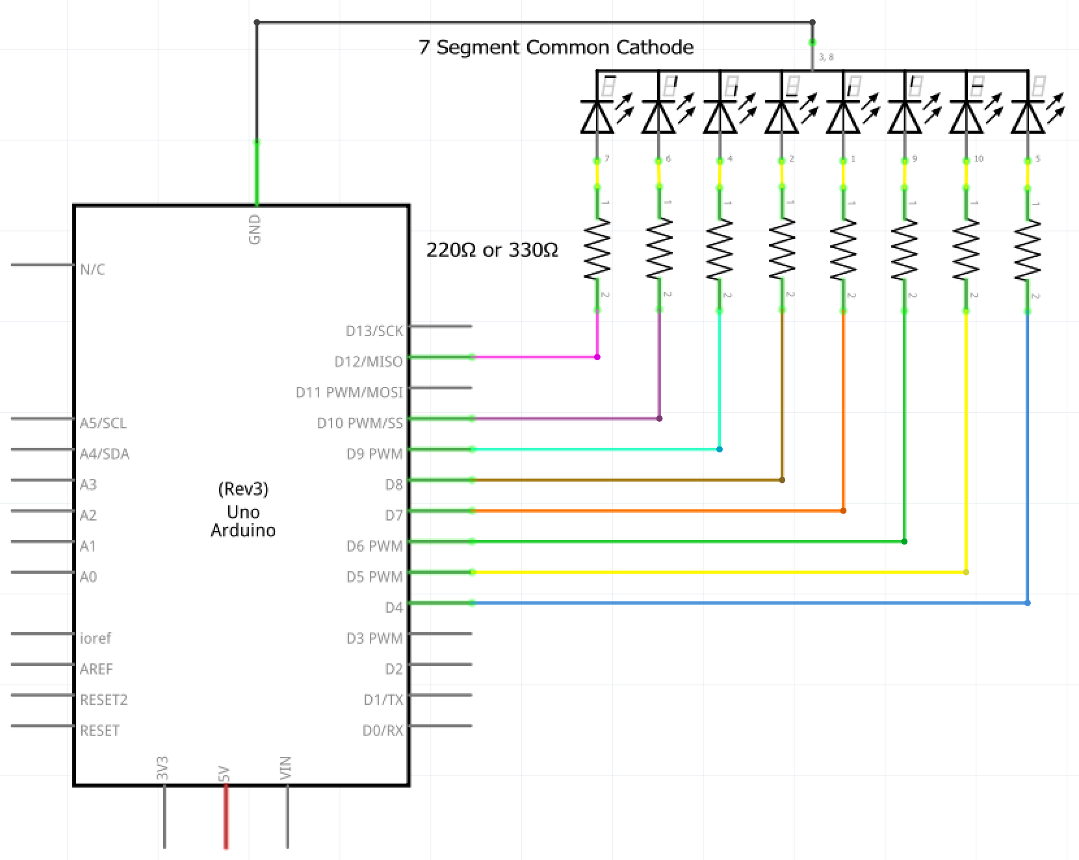
7 Segment display: common cathode

Slide 21
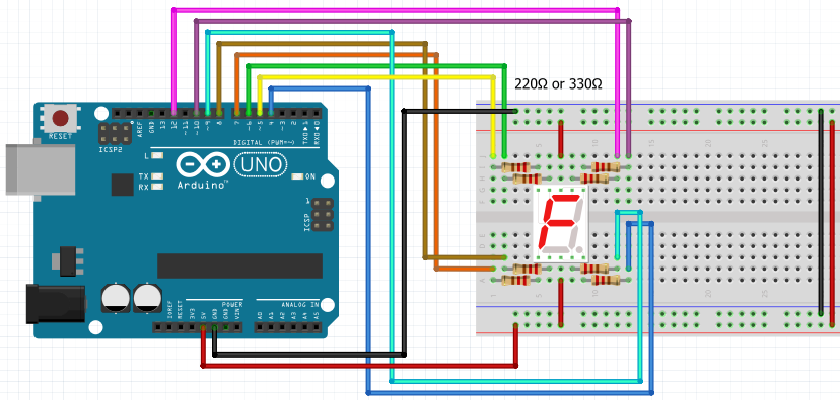
7 Segment display: common anode

Slide 22
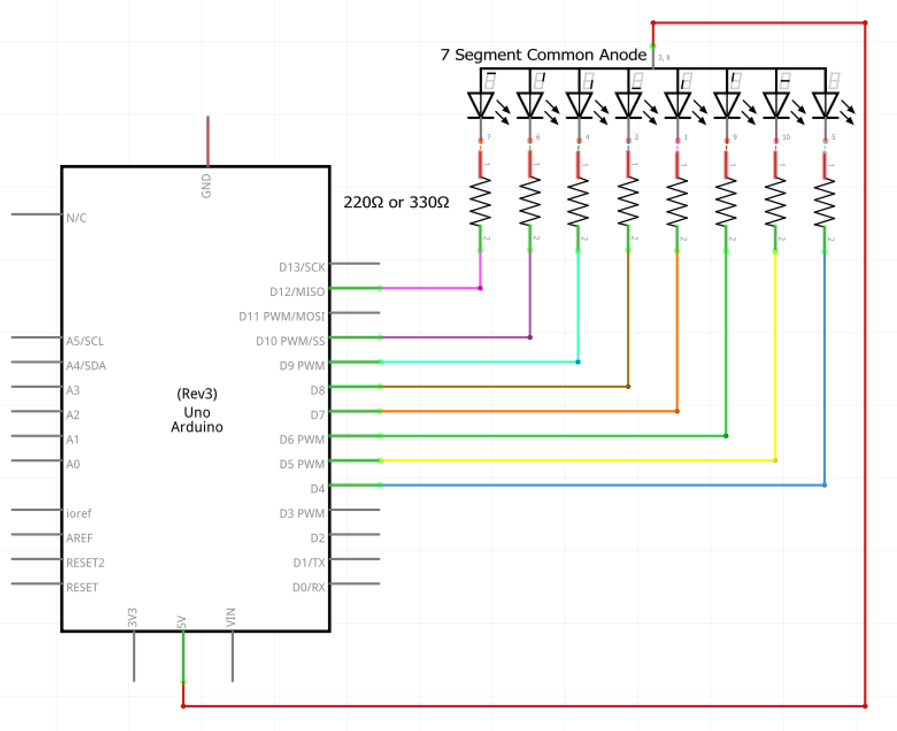
7 Segment display: common anode

Slide 23
Homework
https://www.youtube.com/watch?v=03NsXO1_Q_4

Slide 24
Attendance check
Who’s missing?

Slide 25
Resources
https://circuitdigest.com/microcontroller-projects/interfacing-seven-segment-display-with-Arduino
https://www.circuitbasics.com/arduino-7-segment-display-tutorial/ (notice what’s wrong!)

